Slide 1

Sustainable Mobility Tracker
SRM INSTITUTE OF SCIENCE AND TECHNOLOGY
SCHOOL OF COMPUTING
DEPARTMENT OF COMPUTING TECHNOLOGIES
18CSP107L / 18CSP108L - MAJOR PROJECT / INTERNSHIP
Batch ID: B
Student 1 Reg. No: RA2011003011063
Student 1 Name: Samanyu B Rao
Student 2 Reg. No: RA2011003011096
Student 2 Name: Nivedita Anand
Guide name: Mrs. S. Kanmani
Designation: Assistant Professor Department: Department of Computing Technologies

Slide 2
ABSTRACT
This study addresses the crucial role of adequate CO2 levels in supporting vegetation and ecological balance. However, excessive CO2 emissions from industrial sources and transportation, including land, space, and oceanic vehicles, contribute significantly to the greenhouse effect, global warming, and climate change.
The focus here is on the concern over CO2 emissions from vehicles, particularly cars, and the importance of accurate predictive models for forecasting these emissions.
This work proposes the implementation of four prediction models – Linear Regression, Ridge Regression, Lasso Regression, Random Forest model, Neural Network model and Elastic Net Regression - alongside existing models to enhance the accuracy of forecasting CO2 emissions and guide effective strategies for mitigation.

Slide 3

INTRODUCTION
Our project introduces a web-based application developed using the Flask framework, aimed at predicting and comparing fuel consumption and CO2 emissions of various vehicle models. Leveraging machine learning models, including linear regression, ridge regression, lasso regression, Random Forest model, Neural Network model and elastic net regression, this application provides users with the ability to estimate fuel consumption and CO2 emissions based on user-specified input parameters.

Slide 4
LITERATURE SURVEY
The current systems in place used to predict carbon emissions for upcoming under-development vehicles use three different methods:
Mathematical formulae
Simple standalone Linear Regression Model
Simple standalone Random Forest Regression Model
These existing models are not as accurate for different variations of parameters used in calculating carbon emissions and fuel efficiency. The mathematical formulas provide theoretical values of emissions that can vary drastically from the actual emissions recorded. Therefore, it is of great importance to develop a model that addresses these.

Slide 5
MOTIVATION
Combatting climate change
Improving public health
Optimizing resources
Meeting regulatory standards
Showcasing innovation
Aiding decision-making
Inspiring education

Slide 6
EXISTING LIMITATIONS
The algorithms used in existing systems could be further optimized and in some cases be replaced with better and more efficient algorithms.
Current systems lack the usage of models like Random Forest Model, Neural Network Model and XGBoost model which can provide optimal solutions for the problem.
The margin for error in existing systems is very high and can reduced by adding more systems to account for accuracy of the problem. Also there is errors due to outliers.
Addition of more modules can help us receive more realistic results for the given systems.

Slide 7
Problem statement:
In Predictive models for Co2 Emission, the current systems are confronted with inefficiencies in algorithm usage, missing essential regression models (like Random Forest Model, Neural Network Model and XGBoost model), and a substantial margin for error, all of which hinder the achievement of accurate results. The problem at hand is to enhance the existing systems by optimizing algorithms, incorporating the missing regression models, and reducing the margin for error to improve the accuracy of Co2 Emission Predictive models. We have to also address the issue of the outliers when it comes to such models.
Objective:
1. Enhancing Predictive Models for CO2 Emission Forecasting: This study aims to address the existing gap in predictive modelling for vehicle-related CO2 emissions. It proposes the implementation of four distinct prediction models: Linear Regression, Ridge Regression, Lasso Regression, and Elastic Net Regression. These models are intended to provide more precise forecasts of CO2 emissions from vehicles, thereby contributing to a better understanding of emission patterns.
2. Guiding Effective Mitigation Strategies: By improving the accuracy of CO2 emission forecasts, the study seeks to offer valuable insights for decision-makers, policymakers, and environmental agencies. The enhanced predictive models can assist in anticipating and planning for future CO2 emissions from vehicles, facilitating the development of targeted and efficient strategies for emission reduction and mitigation. This objective aligns with the broader goal of minimizing the adverse environmental impacts of CO2 emissions and fostering sustainable practices.

Slide 8
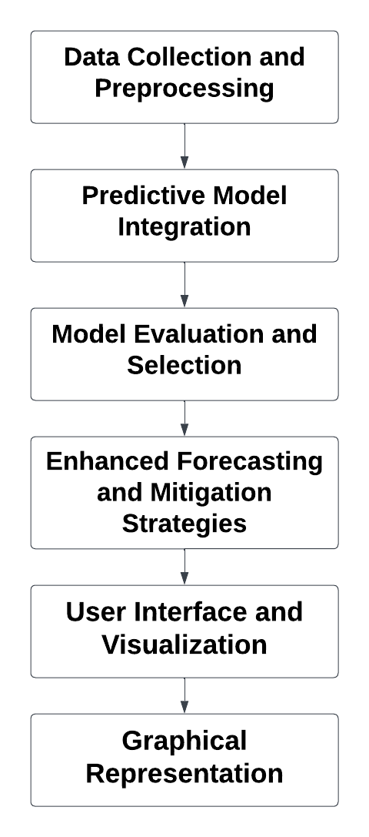
Architecture/Block Diagram of the proposed model:

Slide 9
MODULES DESCRIPTION
Module 1: Data Collection and Preprocessing:
Input: Engine size, Cylinders, Fuel Consumption
Output: Function Parameters
Gather diverse datasets including vehicle attributes, usage patterns, fuel types, driving conditions, historical emission data, and fuel consumption metrics.
Clean and preprocess the data to handle missing values, outliers, and ensure data quality and consistency.
Transform the data into a suitable format for analysis and modelling.
Module 2: Predictive Model Integration:
Input: Function Parameters
Output: Function calculated results
Implement four distinct predictive models: Linear Regression, Ridge Regression, Lasso Regression, random forest, Neural network and Elastic Net Regression.
Train and fine-tune these models using pre-processed data to establish robust relationships between vehicle parameters, CO2 emissions, and fuel efficiency.
Ensure models accurately forecast emissions and calculate fuel efficiency.

Slide 10
MODULES DESCRIPTION
Module 3: Model Evaluation and Selection
Input: Function results of all available models
Output: Most accurate choice from results
Employ various evaluation metrics including MSE, RMSE, R-squared, and custom metrics for fuel efficiency.
Evaluate model performance to identify the most accurate model for generating CO2 emission forecasts and fuel efficiency calculations.
Module 4: Enhanced Forecasting and Mitigation Strategies
Input: Comparison with error rate with resultant values
Output: Final resultant reading
Utilize the selected predictive model to generate precise projections of future CO2 emissions and fuel efficiency measures from vehicles.
Decreasing error rates with enhanced predictive models.

Slide 11
MODULES DESCRIPTION
Module 5: User Interface and Visualization
Input: Final resultant reading
Output: Final Co2 emission reading
Develop an intuitive interface for stakeholders, policymakers, and decision-makers to interact with the predictive model and access emission forecasts and fuel efficiency insights.
Employ data visualization to communicate emission trends, scenario analyses, and potential impacts of mitigation measures effectively.
These five modules encompass critical components for creating a comprehensive system to accurately forecast CO2 emissions, calculate fuel efficiency, and inform impactful mitigation strategies for vehicles.

Slide 12
Innovation Idea for the Project:
Multi-Algorithmic Approach: Introduce an innovative fusion of multiple regression models, including Random Forest Model, Neural Network Model and XGBoost model. This amalgamation harnesses the strengths of each algorithm, enhancing the accuracy and robustness of CO2 emission predictions and fuel efficiency calculations.
Real-Time Data Integration: Implement a dynamic system that integrates real-time data from vehicles. This ensures the model adapts to changing scenarios, providing up-to-the-minute insights for decision-makers and stakeholders.
Continuous Learning Mechanism: Develop a self-learning module within the predictive models to adapt and improve over time. By continuously analyzing the accuracy of predictions against real-world data, the system can autonomously refine its algorithms, ensuring sustained precision and adaptability.
User-Driven Feedback Loop: Incorporate a user feedback mechanism in the web application, allowing users to provide real-world feedback on predicted versus actual CO2 emissions. This loop of information contributes to ongoing model refinement and aligns the system more closely with real-world outcomes.

Slide 13
Scope and Application of the Project:
Transportation Sector Impact: The project's primary scope lies in the transportation sector, addressing CO2 emissions from various vehicles. This includes cars, trucks, and other modes of transportation, making it applicable to both individual and commercial vehicle emissions.
Policy Formulation Support: The accurate predictive models can serve as a vital tool for policymakers and environmental agencies. By providing precise forecasts, the project aids in formulating targeted policies and regulations to curb CO2 emissions effectively.
Global Applicability: The modular and algorithmically diverse approach makes the project universally applicable. It can be customized to suit diverse geographical locations, vehicle types, and regulatory frameworks, ensuring its relevance on a global scale.
Educational Use: The project has the potential for educational applications, serving as a tool for researchers, students, and institutions studying environmental science, data science, and transportation engineering. It provides a practical application for understanding the impact of vehicle attributes on CO2 emissions

Slide 14
References
https://www.mdpi.com/2073-4433/13/11/1871
https://open.canada.ca/data/en/dataset/98f1a129-f628-4ce4-b24d-6f16bf24dd64#wb-auto-6

Slide 15
Questions?

